Slide 1
Lab 1
Basic Text Processing
Prepared by:
Omar Samir

Slide 2
Regular Expressions
Regular expressions are used to:
Identify whether a pattern exists in a given string
Locate the pattern position if exists
To work with regex in python, we will use the built-in module re
>>> import re

Slide 3
Compiling Regular Expressions
Regular expressions are compiled into pattern objects, which have methods for various operations such as searching for pattern matches or performing string substitutions.
>>> import re
>>> p = re.compile('ab*’) //p is a patern object
re.compile() also accepts an optional flags argument
>>> p = re.compile('ab*', re.IGNORECASE) //case insensitive

Slide 4
The Backslash Plague
How to match a backslash character?
In regular expressions all backslashes and metacharacters must be escaped with a backslash so the regular expression that matches a \ is \\
To pass that in a regular python string object each backslash needs to be escaped also by backslashes so we need to pass “\\\\” to match only one backslash.
To solve this problem, we can use python raw string notation for regular expressions where the backslashes are not handled in special way. Python raw string are prefixed with r → r”\” matches just single backslash

Slide 5
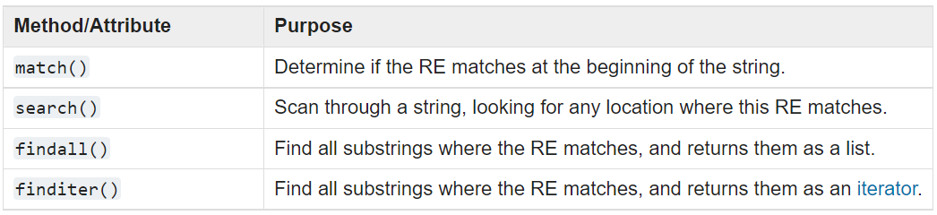
Performing Matches
The re pattern object has several functions to perform a match, we will cover the most important ones in the following table:
Notes:
Both match and search finds the first match only but match matches at the beginning of the string only

Slide 6
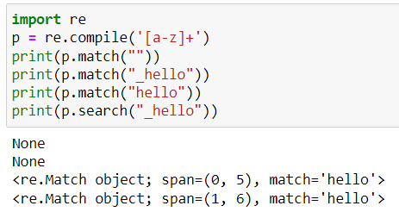
re match() and search()
match() and search() return None if no match can be found. If they’re successful, a match object instance is returned, containing information about the match: where it starts and ends, the substring it matched, and more.

Slide 7
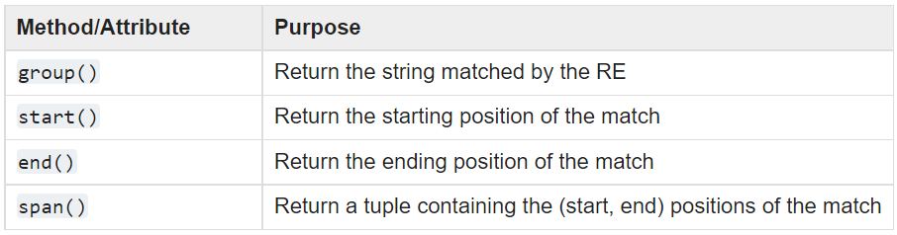
Match Object
The match object contains information about the matched string. you can query the match object using these functions:

Slide 8
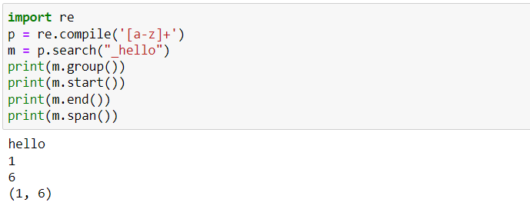
Match Object
Notes:
group(): return the matched string
Start first index of the matched pattern
End -> last index of the matched string
Span -> start and end

Slide 9
re findall()
findall() returns a list of all matched strings

Slide 10
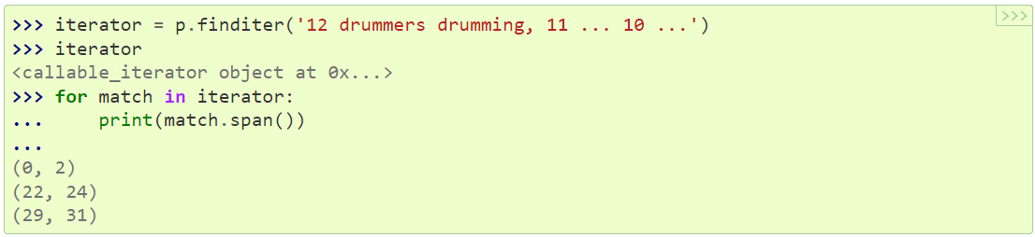
re finditer()
finditer() method returns a sequence of match object instances as an iterator

Slide 11
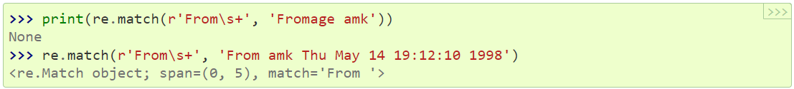
Module-Level Functions
You can use the top-level functions provided by re without creating pattern objects
Use the same functions match(), search(), findall(), finditer() by passing them the pattern then the string

Slide 12
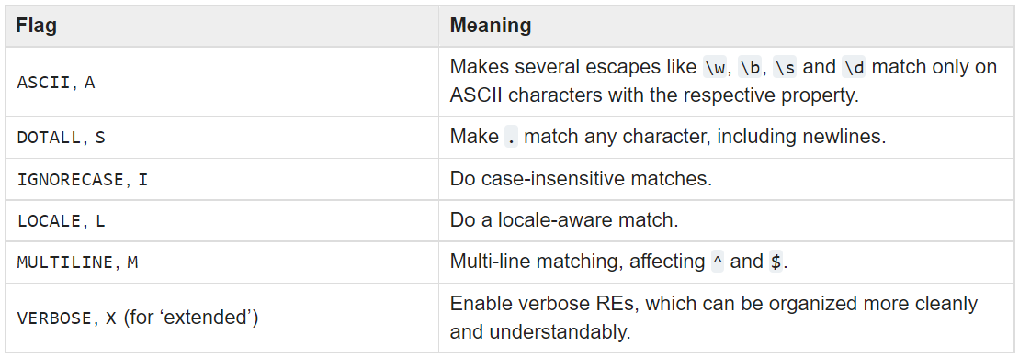


Compilation Flags
Compilation flags let you modify some aspects of how regular expressions work. The following table shows these flags:
Notes:
LOCALE: e in france
Mn 8er dotall -> al dot m4 bt3ml match le al end of the line

Slide 13
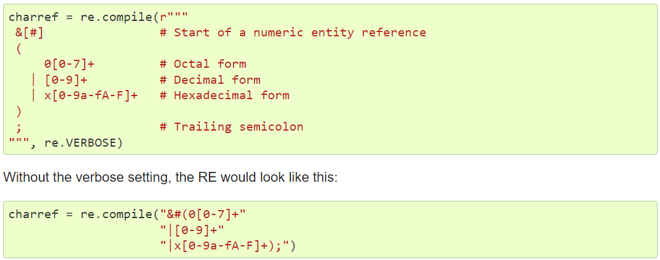
Compilation Flags

Slide 14
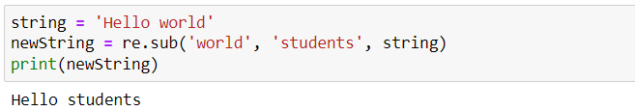
re.sub()
Substitutes part of a string

Slide 15
Tokenization
Tokenization is the task of cutting a string into identifiable linguistic units that constitute a piece of language data.
The simplest approach is to split text on white space
>>> re.split(r' ', raw)
What about tabs and newlines? What about double, triple white spaces?
>>> re.split(r'[ \t\n]+', raw)
Or
>>> re.split(r'\s+', raw)

Slide 16
Tokenization
Splitting on whitespace gives us tokens like '(not' and 'herself,' to solve that we can split on all characters that are not word characters
>>> re.split(r'\W+', raw)
What about finding word characters instead of splitting on non word characters?
Notes:
‘’ -> eg3t 34an start of the line is non word so it will spilt and return before and after it

Slide 17
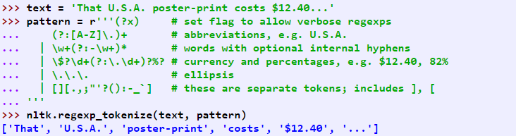
NLTK's Regular Expression Tokenizer
The function nltk.regexp_tokenize() is similar to re.findall() (as we've been using it for tokenization). However, nltk.regexp_tokenize() is more efficient for this task
Notes:
re.findall(r'^.*(?:ing|ly)$', 'processing')

Slide 18

Stemming
The task of stripping off any affixes
Notes:
Findall returns list of matches and each match contain the capturing groups

Slide 19
Stemming
NLTK includes several off-the-shelf stemmers, and if you ever need a stemmer you should use one of these in preference to crafting your own using regular expressions, since these handle a wide range of irregular cases.
Two popular stemmers in NLTK:
Porter stemmer
Lancaster stemmer

Slide 20
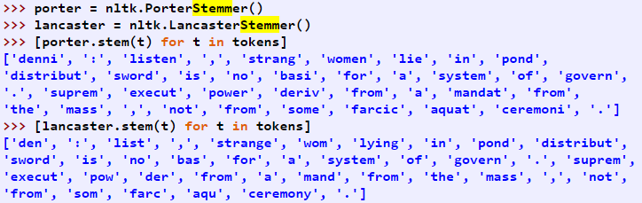
Stemming

Slide 21

Lemmatization
The task of determining that two words have the same root
The lemmatizer is slower than stemmers
NLTK contains the WordNetLemmatizer
E.g. “women” → “woman”

Slide 22
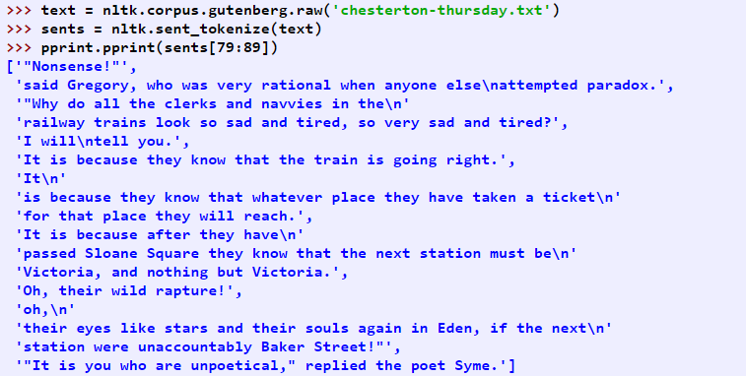
Sentence Segmentation
NLTK facilitates this by including the Punkt sentence segmenter (Kiss & Strunk, 2006)

Slide 23
References
https://docs.python.org/3/howto/regex.html
https://www.nltk.org/book/ch03.html

